Slide 1

Programming concepts RISC V
COMPUTER ORGANISATION & ARCHITECTURE

Slide 2
Programming
Software languages such as C or Java are called high-level programming languages because they are written at a more abstract level than assembly language.
Many high-level languages use common software constructs.
High-level constructs: loops, conditional statements, arrays, function calls.

Slide 3
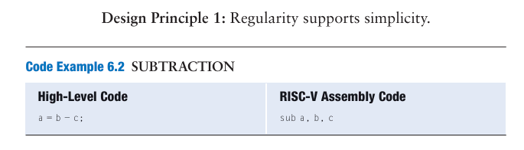
DESIGN PRINCIPLES
The first part of the assembly instruction, add, is called the mnemonic and indicates what operation to perform.
The operation is performed on b and c, the source operands, and the result is written to a, the destination operand.
Instructions with a consistent number of operands—in this case, two sources and one destination.

Slide 4
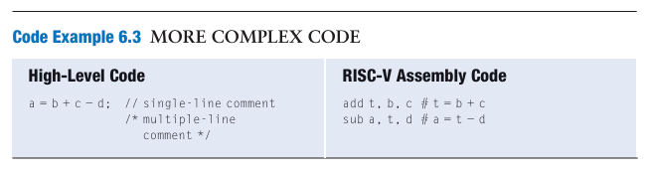
Design Principle 2 : Make the common case fast.
In the high-level language examples, single-line comments begin with // and continue until the end of the line.
Multiline comments begin with /* and end with */.
In RISC-V assembly language, only single-line comments are used. They begin with a hash symbol (#) and continue until the end of the line.
The RISC-V instruction set makes the common case fast by including only simple, commonly used instructions.

Slide 5
Operands: Registers, Memory, and Constants
An instruction operates on operands
The variables a, b, and c are all operands.
But computers operate on 1’s and 0’s, not variable names.
The instructions need a physical location from which to retrieve the binary data.
Operands can be stored in registers or memory, or they may be constants stored in the instruction itself.
RISC-V is called a 32-bit architecture because it operates on 32-bit data.

Slide 6
Registers
Design Principle 3: Smaller is faster.
Instructions need to access operands quickly so that they can run fast, but operands stored in memory take a long time to retrieve.
Therefore, most architectures specify a small number of registers that hold commonly used operands.
The RISC-V architecture has 32 registers, called the register set, stored in a small multi-ported memory called a register file.
The fewer the registers, the faster they can be accessed.

Slide 7
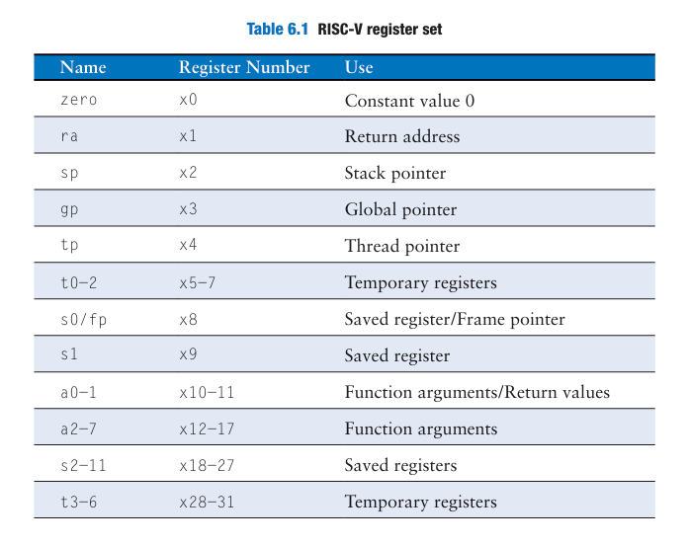
Assembly instructions typically use the special name
The zero register always holds the constant 0; values written to it are discarded.
Registers s0 to s11 (registers 8–9 and 18–27) and t0 to t6 (registers 5–7 and 28–31) are used for storing variables
ra and a0 to a7 have special uses during function calls,
Registers 2 to 4 → sp, gp, and tp

Slide 9
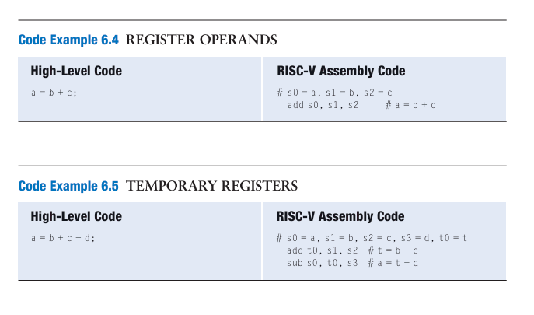
Design Principle 3: Smaller is faster
The instruction adds the 32-bit values contained in s1 (b) and s2 (c) and writes the 32-bit result to s0 (a).
RISC-V assembly code using a register, t0, to store the intermediate calculation of b+c.

Slide 10
Question
Translate the following high-level code into RISC-V assembly language. Assume variables a−c are held in registers s0−s2, and f−j are in s3−s7.
// high-level code
a = b − c;
f = (g + h) − (i + j);

Slide 11
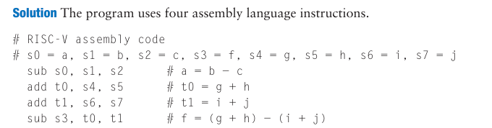

Slide 12
Constants/Immediates
RISC-V instructions can use constant or immediate operands.
These constants are called immediates because their values are immediately available from the instruction and do not require a register or memory access.
In assembly code, the immediate can be written in decimal, hexadecimal, or binary.
Hexadecimal constants in RISC-V start with 0x and binary constants start with 0b,
Immediates are 12-bit two’s complement numbers, so they are sign-extended to 32 bits.
The addi instruction is a useful way to initialize register values with small constants.
Eg: addi s5,x0,0b1101101
addi s5,x0,0x6D
addi s5,x0,109

Slide 13
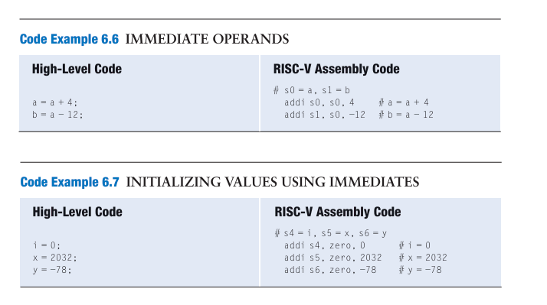

Slide 14
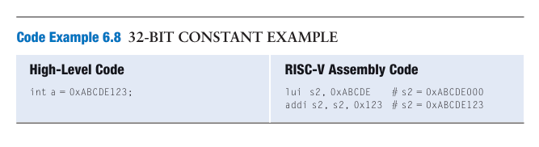
Load upper immediate instruction (lui)
To create larger constants, use a load upper immediate instruction (lui) followed by an add immediate instruction (addi)
The lui instruction loads a 20-bit immediate into the most significant 20 bits of the instruction and places zeros in the least significant bits.

Slide 15
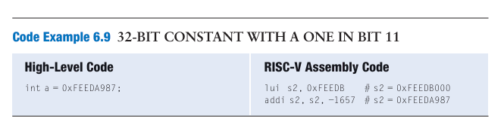
When creating large immediates, if the 12-bit immediate in addi is negative , the upper immediate in the lui must be incremented by one.
Desired immediate = 0xFEEDA987.
lui s2, 0xFEEDB puts 0xFEEDB000 into s2. (The desired 20-bit upper immediate, 0xFEEDA, is incremented by 1).
0x987 is the 12-bit representation of −1657,
so addi s2, s2, −1657 adds s2 and the sign- extended 12-bit immediate (0xFEEDB000 + 0xFFFFF987 = 0xFEEDA987)

Slide 16
Memory
The register file is small and fast, memory is larger and slower.
For this reason, frequently used variables are kept in registers.
In the RISC-V architecture, instructions operate exclusively on registers, so data stored in memory must be moved to a register before it can be processed.
Memories are organized as an array of data words.
The RISC-V architecture uses 32-bit memory addresses and 32-bit data words.
RISC-V uses a byte-addressable memory.
Each byte in memory has a unique address

Slide 17
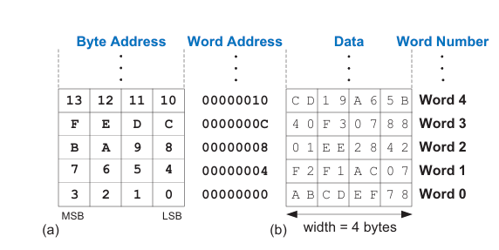
A 32-bit word consists of four 8-bit bytes, so each word address is a multiple of 4.

Slide 18
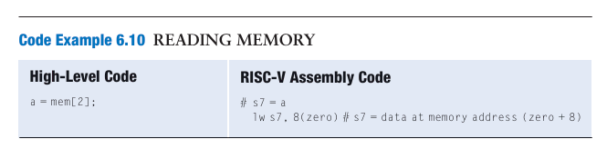
The load word instruction, lw, reads a data word from memory into a register.
Word number 0 is at address 0, word 1 is at address 4, word 2 at address 8, and so on.

Slide 19
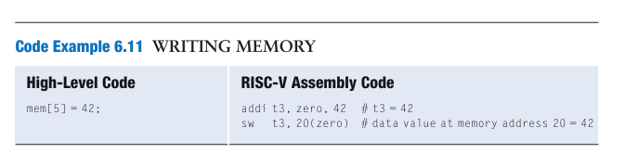
The store word instruction, sw, writes a data word from a register into memory.
Eg: Writes the value 42 from register t3 into memory word 5, located at address 20

Slide 20
Thankyou

